Slide 1
Conditional Probabilities Bayes Theorem Dr. Kamesam

Slide 2
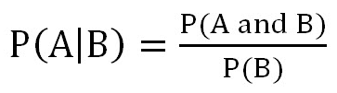
Definition of Conditional Probability
Corollary: The Chain Rule
P(A and B) = P(A|B) P(B)

Slide 3
Independent Events
Two events A and B said to be independent if the occurrence of B has no impact on the occurrence of A
P ( A | B ) = P (A)
P ( B | A ) = P (B)
Another way of stating the above independence is
P ( A & B ) = P (A) * P(B)
If there are k events A₁, A₂, ……….., A_{k}
P ( A₁ & A₂ & …& A_{k}) = P(A₁) * P(A₂) * …….* P(A_{k})

Slide 4
Bayes Theorem
As we will see later, this can be very useful in practice.
If A has NO impact on B, then P(B|A) = P(B), or A and B are independent

Slide 5
Example of Bayes Theorem
Given:
A doctor knows that meningitis causes stiff neck 50% of the time
Prior probability of any patient having meningitis is 1/50,000
Prior probability of any patient having stiff neck is 1/20
If a patient has stiff neck, what’s the probability he/she has meningitis?

Slide 6
Conditional Probability
Given any two events E and F,
P(E) = P(E| F).P(F) + P(E | F^{c}).P(F^{c})

Slide 7
Example: Rain Prediction
Marie is getting married tomorrow, at an outdoor ceremony in the desert. In recent years, it has rained only 5 days each year. Unfortunately, the weatherman has predicted rain for tomorrow. When it actually rains, the weatherman correctly forecasts rain 90% of the time. When it doesn't rain, he incorrectly forecasts rain 10% of the time. What is the probability that it will rain on the day of Marie's wedding?
Solution: The sample space is defined by two mutually-exclusive events - it rains or it does not rain. Additionally, a third event occurs when the weatherman predicts rain. Notation for these events appears below.
Event A₁. It rains on Marie's wedding.
Event A₂. It does not rain on Marie's wedding.
Event B. The weatherman predicts rain.
Source: ww.startrek.com

Slide 8
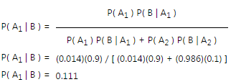
Rain Prediction Example, Contd
In terms of probabilities, we know the following:
P( A₁ ) = 5/365 =0.0136985 [It rains 5 days out of the year.]
P( A₂ ) = 360/365 = 0.9863014 [It does not rain 360 days out of the year.]
P( B | A₁ ) = 0.9 [When it rains, the weatherman predicts rain 90% of the time.]
P( B | A₂ ) = 0.1 [When it does not rain, the weatherman predicts rain 10% of the time.]
We want to know P( A₁ | B ), the probability it will rain on the day of Marie's wedding, given a forecast for rain by the weatherman. The answer can be determined from Bayes' theorem

Slide 9
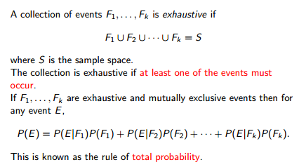
Total Probability

Slide 10
Text Classification and Naïve Bayes
Dr. Kamesam
Some of these charts are from Prof. Jurafsky, Stanford University

Slide 11
Naïve Bayes Classification Algorithm
Naïve Bayes is a Classification algorithm which can be used for any general classification problem
Text classification is an application which can be solved with many different classification algorithms
I am teaching both these together, just to save some time.
Naïve Bayes works well in some text classification problems (like SPAM classification)
Notes:
#1: Saigon. Grey, Anthony
#2: Jerusalem the Golden. Drabble, Margaret
From shlomo argamon

Slide 12
Reading
“Spambase” dataset. It is on BB. You can get started by getting hold of the data and metadata. Read the metadata and understand how it was created. I posted the metadata also in the same xls file.
HW 6 is on SPAM mail classification. It is on BB
READING FOR NAÏVE BAYES: p97-99, p451-454 in the textbook

Slide 13
Is This SPAM ?
Dear SIR,
I am Mr. John Coleman and my sister is Miss Rose Colemen, we are the children of late Chief Paul Colemen from Sierra Leone. I am writing you in absolute confidence primarily to seek your assistance to transfer our cash of twenty one Million Dollars ($21,000,000.00) now in the custody of a private Security trust firm in Europe the money is in trunk boxes deposited and declared as family valuables by my late father as a matter of fact the company does not know the content as money, although my father made them to under stand that the boxes belongs to his foreign partner.
…

Slide 14
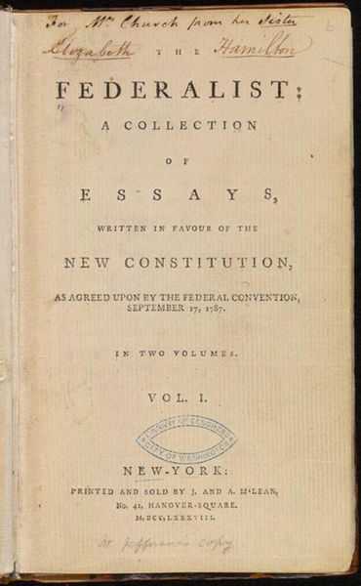
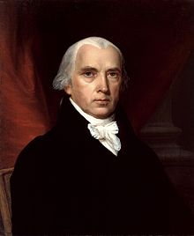
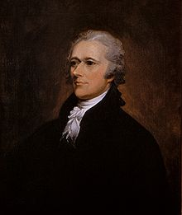
Who wrote which Federalist papers?
1787-8: anonymous essays try to convince New York to ratify U.S Constitution: Madison, Hamilton.
Authorship of 12 of the letters in dispute
1963: solved by Mosteller and Wallace using Bayesian methods
James Madison
Alexander Hamilton

Slide 15
Male or female author?
By 1925 present-day Vietnam was divided into three parts under French colonial rule. The southern region embracing Saigon and the Mekong delta was the colony of Cochin-China; the central area with its imperial capital at Hue was the protectorate of Annam…
Clara never failed to be astonished by the extraordinary felicity of her own name. She found it hard to trust herself to the mercy of fate, which had managed over the years to convert her greatest shame into one of her greatest assets…
S. Argamon, M. Koppel, J. Fine, A. R. Shimoni, 2003. “Gender, Genre, and Writing Style in Formal Written Texts,” Text, volume 23, number 3, pp. 321–346
Notes:
#1: Saigon. Grey, Anthony
#2: Jerusalem the Golden. Drabble, Margaret
From shlomo argamon

Slide 16


Positive or negative movie review?
unbelievably disappointing
Full of zany characters and richly applied satire, and some great plot twists
this is the greatest screwball comedy ever filmed
It was pathetic. The worst part about it was the boxing scenes.
More general Question: Given a document, what is the sentiment ?

Slide 17
What is the subject of this article?
MEDLINE Article
MeSH Subject Category Hierarchy
Antogonists and Inhibitors
Blood Supply
Chemistry
Drug Therapy
Embryology
Epidemiology
…
?
MeSH : medical subject Heading

Slide 18
Text Classification
Assigning subject categories, topics, or genres
Spam detection
Authorship identification
Age/gender identification
Language Identification
Sentiment analysis
…

Slide 19
Text Classification: definition
Input:
a document d
a fixed set of classes C = {c₁, c₂,…, c_{J}}
Output: a predicted class c ∈ C

Slide 20
Classification Methods: Hand-coded rules
Rules based on combinations of words or other features
spam: black-list-address OR (“dollars” AND“have been selected”)
Accuracy can be high
If rules carefully refined by expert
But building and maintaining these rules is expensive

Slide 21
Classification Methods: Supervised Machine Learning
Input:
a document d
a fixed set of classes C = {c₁, c₂,…, c_{J}}
A training set of m hand-labeled documents (d₁,c₁),....,(d_{m},c_{m})
Output:
a learned classifier γ:d → c

Slide 22
Classification Methods: Supervised Machine Learning
Any kind of classifier
Naïve Bayes
Logistic regression
Support-vector machines
k-Nearest Neighbors
…

Slide 23
Text Classification and Naïve Bayes
The Task of Text Classification

Slide 24
Naïve Bayes Intuition
Simple (“naïve”) classification method based on Bayes rule
Relies on very simple representation of document
Bag of words

Slide 25
The bag of words representation
I love this movie! It's sweet, but with satirical humor. The dialogue is great and the adventure scenes are fun… It manages to be whimsical and romantic while laughing at the conventions of the fairy tale genre. I would recommend it to just about anyone. I've seen it several times, and I'm always happy to see it again whenever I have a friend who hasn't seen it yet.
γ(
)=c

Slide 26
The bag of words representation
I love this movie! It's sweet, but with satirical humor. The dialogue is great and the adventure scenes are fun… It manages to be whimsical and romantic while laughing at the conventions of the fairy tale genre. I would recommend it to just about anyone. I've seen it several times, and I'm always happy to see it again whenever I have a friend who hasn't seen it yet.
γ(
)=c
Notes:
筛选关键字

Slide 27
The bag of words representation: using a subset of words
x love xxxxxxxxxxxxxxxx sweet xxxxxxx satirical xxxxxxxxxx xxxxxxxxxxx great xxxxxxx xxxxxxxxxxxxxxxxxxx fun xxxx xxxxxxxxxxxxx whimsical xxxx romantic xxxx laughing xxxxxxxxxxxxxxxxxxxxxxxxxxxxxxxxxxxxxxxxxxxx recommend xxxxx xxxxxxxxxxxxxxxxxxxxxxxxxxxxxxxx several xxxxxxxxxxxxxxxxx xxxxx happy xxxxxxxxx again xxxxxxxxxxxxxxxxxxxxxxxxxxxxxxxxxxxxxxxxxxxxxxx
γ(
)=c

Slide 28
The bag of words representation
great | 2
love | 2
recommend | 1
laugh | 1
happy | 1
... | ...
γ(
)=c
We are extracting some “features”, or attributes of the document
Notes:
关键字出现次数放入函数得出结论c

Slide 29
Text Classification and Naïve Bayes
Formalizing the Naïve Bayes Classifier

Slide 30
Naïve Bayes Algorithm
This algorithm may be applied in many different situations, although the example we start with is on Text Classification
Text Classification is a natural example, where it works well.

Slide 31
Bayes’ Rule Applied to Documents and Classes
For a document d and a class c

Slide 32
Naïve Bayes Classifier (I)
We want to find that class c , which maximizes the conditional prob. P(c | document)
MAP is “maximum a posteriori” = most likely class
Bayes Rule
Dropping the denominator

Slide 33
Naïve Bayes Classifier (II)
Document d represented as features x1..xn

Slide 34
Multinomial Naïve Bayes Independence Assumptions
Bag of Words assumption: Assume position doesn’t matter
Conditional Independence: Assume the feature probabilities P(x_{i}|c_{j}) are independent given the class c.

Slide 35
To simplify the task, naïve Bayesian classifiers assume attributes have independent distributions, and thereby estimate
p(d|c_{j}) = p(x₁|c_{j}) * p(x₂|c_{j}) * ….* p(x_{n}|c_{j})
The probability of class c_{j} generating instance d, equals….
The probability of class c_{j} generating the observed value for feature 1, multiplied by..
The probability of class c_{j} generating the observed value for feature 2, multiplied by..

Slide 36
Multinomial Naïve Bayes Classifier

Slide 37
Text Classification and Naïve Bayes
Naïve Bayes: Learning from the training corpus

Slide 38
Learning the Multinomial Naïve Bayes Model
Sec.13.3
First attempt: maximum likelihood estimates
simply use the frequencies in the data
← # training documents of class C _{j}
← N = Total # of training documents
← # times x _{i} appears in the training documents of class C _{j}
← # training documents of class C _{j}

Slide 39
Parameter estimation
fraction of times word w appears
among all words in documents of topic c_{j}
Create mega-document for topic j by concatenating all docs in this topic
Use frequency of w in mega-document

Slide 40
Problem with Maximum Likelihood
Sec.13.3
What if we have seen no training documents with the word fantastic and classified in the topic positive (thumbs-up)?
Zero probabilities cannot be conditioned away, no matter the other evidence!

Slide 41
Smoothing the Naïve Bayes estimates
Laplace (add-1):
# of values of X_{i}
Applied to text:
Where V = vocabulary in the training data
|V| = vocabulary size = # words in the training sample

Slide 42
Multinomial Naïve Bayes: Learning
From training corpus, extract Vocabulary
Calculate P(c_{j}) terms
For each c_{j} in C do
docs_{j} ← all docs with class =c_{j}
Calculate P(w_{k} | c_{j}) terms
Text_{j} ← single doc containing all
documents of class j
For each word w_{k} in Vocabulary of
all training data
n_{k} ← # of occurrences of w_{k} in Text_{j}
n ← No. of Words in Text _{j}

Slide 43
Text Classification and Naïve Bayes
Multinomial Naïve Bayes: A Worked Example

Slide 44
Laplace Correction (smoothing)

Slide 45

 | Doc | Words | Class
Training | 1 | Chinese Beijing Chinese | c
 | 2 | Chinese Chinese Shanghai | c
 | 3 | Chinese Macao | c
 | 4 | Tokyo Japan Chinese | j
Test | 5 | Chinese Chinese Chinese Tokyo Japan | ?
Priors:
P(c)=
P(j)=
3
4
1
Choosing a class:
P(c|d5)
P(j|d5)
4
3/4 * (3/7)³ * 1/14 * 1/14
≈ 0.0003
Conditional Probabilities:
P(Chinese|c) =
P(Tokyo|c) =
P(Japan|c) =
P(Chinese|j) =
P(Tokyo|j) =
P(Japan|j) =
(5+1) / (8+6) = 6/14 = 3/7
(0+1) / (8+6) = 1/14
1/4 * (2/9)³ * 2/9 * 2/9
≈ 0.0001
(0+1) / (8+6) = 1/14
(1+1) / (3+6) = 2/9
(1+1) / (3+6) = 2/9
So, classify d5 as belonging to Class c
(1+1) / (3+6) = 2/9

Slide 46
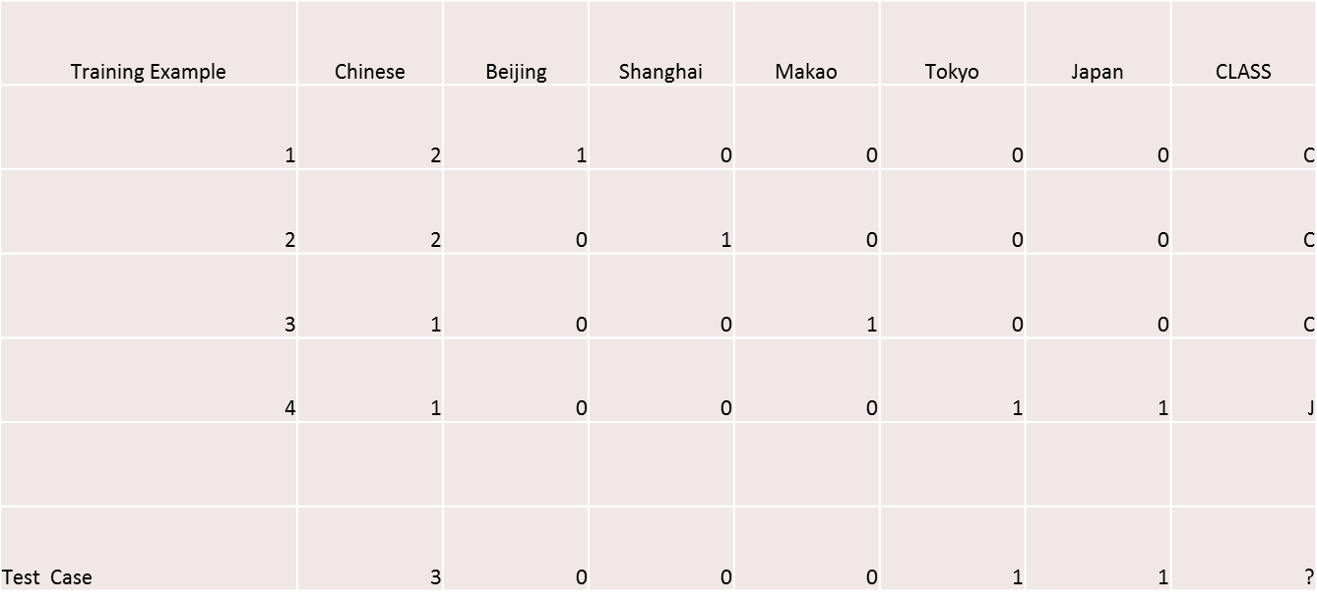
Data File for Example

Slide 47
Naïve Bayes in Spam Filtering
SpamAssassin Features:
Mentions Generic Viagra
Online Pharmacy
Mentions millions of (dollar) ((dollar) NN,NNN,NNN.NN)
Phrase: impress ... girl
From: starts with many numbers
Subject is all capitals
HTML has a low ratio of text to image area
One hundred percent guaranteed
Claims you can be removed from the list
'Prestigious Non-Accredited Universities'
http://spamassassin.apache.org/tests_3_3_x.html

Slide 48
Summary: Naive Bayes is Not So Naive
Very Fast, low storage requirements
Robust to Irrelevant Features
Irrelevant Features cancel each other without affecting results
Very good in domains with many equally important features
Decision Trees suffer from fragmentation in such cases – especially if little data
Optimal if the independence assumptions hold: If assumed independence is correct, then it is the Bayes Optimal Classifier for problem
Handles real and discrete data
Handles streaming data well
A good dependable baseline for text classification, But we will see other classifiers that give better accuracy

Slide 49
Text Classification and Naïve Bayes
SPSS Modeler Demo

Slide 50
Text Classification and Naïve Bayes
Example 2

Slide 51
Play-tennis example: estimate P(x_{i}|C)
Class = P (Play) Class = N (No Play)
outlook
P(sunny|p) = 2/9 | P(sunny|n) = 3/5
P(overcast|p) = 4/9 | P(overcast|n) = 0
P(rain|p) = 3/9 | P(rain|n) = 2/5
Temperature
P(hot|p) = 2/9 | P(hot|n) = 2/5
P(mild|p) = 4/9 | P(mild|n) = 2/5
P(cool|p) = 3/9 | P(cool|n) = 1/5
Humidity
P(high|p) = 3/9 | P(high|n) = 4/5
P(normal|p) = 6/9 | P(normal|n) = 2/5
windy
P(true|p) = 3/9 | P(true|n) = 3/5
P(false|p) = 6/9 | P(false|n) = 2/5
Prior Probabilities
P(p) = 9/14
P(n) = 5/14

Slide 52
Tennis Example
The data samples are described by attributes outlook, temperature, humidity and wind. The class label attribute, PlayTennis, tells whether the person will play tennis or not, has two distinct values, yes (Class C1) and no (Class C2).
The sample we wish to classify is
X = (outlook=sunny, temperature=cool, humidity = high, wind=strong)
We need to maximize P(X|C _{j})P(C _{j}), for j = 1, 2.
P(C _{j}), the a priori probability of each class, can be estimated based on the training samples:

Slide 53
Tennis Example 2: Description
X = (outlook=sunny, temperature=cool, humidity = high, wind=strong)
To compute P(X|C _{j} ), for j = 1, 2, we compute the following conditional probabilities:

Slide 54
Tennis Example: Classify a new sample
X = (outlook=sunny, temperature=cool, humidity = high, wind=strong)
Using probabilities from the previous two pages we can compute the probability in question:
h_{MAP} is not to play tennis

Slide 55
Evaluation: Classic Reuters-21578 Data Set
Sec. 15.2.4
Most (over)used data set, 21,578 docs (each 90 types, 200 toknens)
9603 training, 3299 test articles (ModApte/Lewis split)
118 categories
An article can be in more than one category
Learn 118 binary category distinctions
Average document (with at least one category) has 1.24 classes
Only about 10 out of 118 categories are large
Earn (2877, 1087)
Acquisitions (1650, 179)
Money-fx (538, 179)
Grain (433, 149)
Crude (389, 189)
Trade (369,119)
Interest (347, 131)
Ship (197, 89)
Wheat (212, 71)
Corn (182, 56)
Common categories
(#train, #test)

Slide 56
Text Classification and Naïve Bayes
Text Classification: Practical Issues

Slide 57
The Real World
Sec. 15.3.1
Gee, I’m building a text classifier for real, now!
What should I do?

Slide 58
Very little data?
Sec. 15.3.1
Use Naïve Bayes
Naïve Bayes is a “high-bias” algorithm (Ng and Jordan 2002 NIPS)
Get more labeled data
Find clever ways to get humans to label data for you
Try semi-supervised training methods:
Bootstrapping, EM over unlabeled documents, …

Slide 59
A reasonable amount of data?
Sec. 15.3.1
Perfect for all the clever classifiers
The following classifiers are worth trying and should do well
SVM
Regularized Logistic Regression
You can even use user-interpretable decision trees

Slide 60
A huge amount of data?
Sec. 15.3.1
Can achieve high accuracy!
At a cost:
SVMs (train time) or kNN (test time) can be too slow
Regularized logistic regression can be somewhat better
So Naïve Bayes can come back into its own again!

Slide 61
Accuracy as a function of data size
Sec. 15.3.1
With enough data
Classifier may not matter
Brill and Banko on spelling correction

Slide 62
Real-world systems generally combine:
Automatic classification
Manual review of uncertain/difficult/"new” cases

Slide 63
How to tweak performance
Sec. 15.3.2
Domain-specific features and weights: very important in real performance
Sometimes need to collapse terms:
Part numbers, chemical formulas, …
But stemming generally doesn’t help
Upweighting: Counting a word as if it occurred twice:
title words (Cohen & Singer 1996)
first sentence of each paragraph (Murata, 1999)
In sentences that contain title words (Ko et al, 2002)

Slide 64
No training data? Manually written rules
Sec. 15.3.1
If (wheat or grain) and not (whole or bread) then
Categorize as grain
Need careful crafting
Human tuning on development data
Time-consuming: 2 days per class

Slide 65
end of presentation

Slide 66
NAÏVE BAYES CLASSIFIER

Slide 67
Bayes Classifier
A probabilistic framework for solving classification problems
A, C random variables
Joint probability: Pr(A=a,C=c)
Conditional probability: Pr(C=c | A=a)
Relationship between joint and conditional probability distributions
Bayes Theorem:

Slide 68
Bayesian Classifiers
Consider each attribute and class label as random variables
Given a record with attributes (A₁, A₂,…,A_{n})
Goal is to predict class C
Specifically, we want to find the value of C that maximizes P(C| A₁, A₂,…,A_{n} )
Can we estimate P(C| A₁, A₂,…,A_{n} ) directly from data?

Slide 69
Bayesian Classifiers
Approach:
compute the posterior probability P(C | A₁, A₂, …, A_{n}) for all values of C using the Bayes theorem
Choose value of C that maximizes P(C | A₁, A₂, …, A_{n})
Equivalent to choosing value of C that maximizes P(A₁, A₂, …, A_{n}|C) P(C)
How to estimate P(A₁, A₂, …, A_{n} | C )?

Slide 70
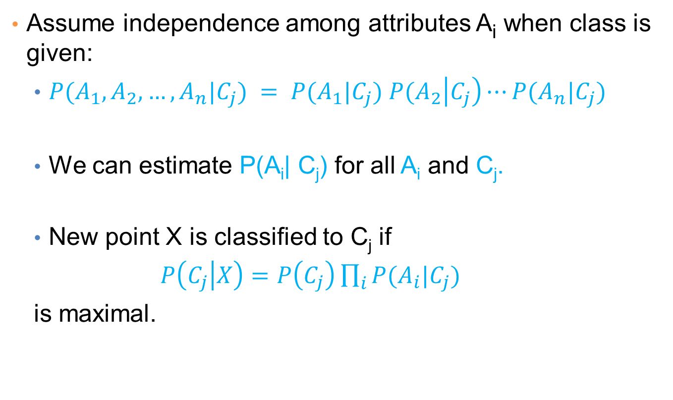
Naïve Bayes Classifier
Assume independence among attributes A_{i} when class is given:
$P(A_{1},A_{2},…,A_{n}|C_{j}) = P(A_{1}|C_{j}) P(A_{2}\left|C_{j}\right)⋯P(A_{n}|C_{j})$
We can estimate P(A_{i}| C_{j}) for all A_{i} and C_{j}.
New point X is classified to C_{j} if
$P\left(C_{j} | X\right)=P\left(C_{j}\right)\prod_{i}{P(A_{i}|C_{j})}$
is maximal.

